Slide 1
OBJECT TRACKING
Brian Lee
Chris Kamau

Slide 2
Used OPENCV
Free, Convenient
Not trivial, documentation could be better.
Strategy
ACQUIRE OBJECT TO BE TRACKED
USE FEATURE DETECTION ALGORITHM
FEEDBACK TO USER

Slide 3
Object Acquisition
Started out with webcam feeds
Easy and Straightforward
Extended to allow videos
User selects object to be tracked by dragging cursor over object

Slide 4
Feature Detection
Used opencv’s SURF(Speeded Up Robust Features) algorithm implementation
How it works
Calculate unique key points in scene and object
Calculate descriptors using key points
Use matcher to find common descriptors found in scene and object
Find good matches( distance based criteria )
Extract scalar location

Slide 5
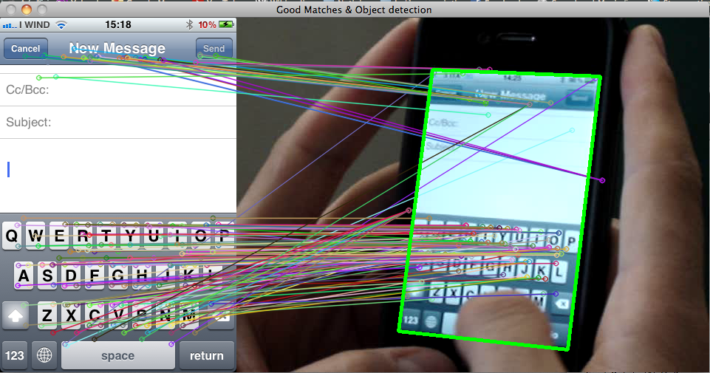
SURF’ing
http://answers.opencv.org/upfiles/13437458694482562.png

Slide 6
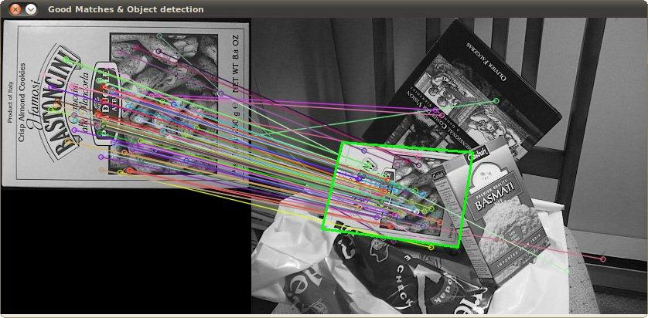
SURF’ing
http://2.bp.blogspot.com/-rKDfJNUkTfM/T0ulpZFsOII/AAAAAAAAADY/WwvWvGogWmY/s1600/aim.jpg

Slide 7
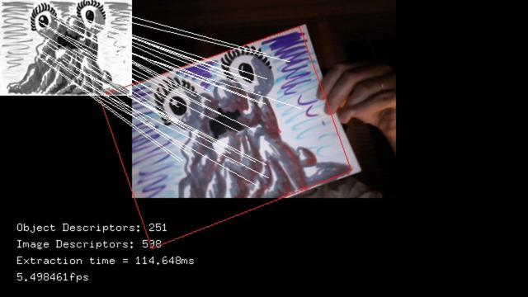
SURF’ing
http://answers.opencv.org/upfiles/13437458694482562.png

Slide 8
Feedback
Once the user has selected their object
Each frame that follows has feature detection performed on it
Distinct border is rendered around the object in scene.
Rendered Frame is output to video
Algorithm is slow( we considered multi-threading )
Real time processing leads to choppy stream.
Video can have a smooth fixed frame rate for better demonstration

Slide 9
Take Away
SURF isn’t perfect
A lot of false positives
Only works well if tracking distinct objects in scene(no homogenous objects and scenes )
SURF is easy to implement

